Slide 1
SPORTS ACADEMY
Date | Transaction Type | Num | Name | Memo/Description | Amount
11/18/2018 | Check | 12567 | TEJPAL SINGH | Reimbursement | 1,901.26
11/18/2018 | Check | 12568 | NEW HAVEN UNIFIED SCHOOL DISTRICT | RENT FOR THE MONTH OF OCT. 2018 FOR SPORTS GROUNDS | 2,600.82
11/25/2018 | Check | 12595 | HARSATNAM SINGH | Reimbursement | 987.52
12/16/2018 | Check | 12626 | NEW HAVEN UNIFIED SCHOOL DISTRICT | Inv # 11204 permit no.INM/19-051 dt dec 6. 2018 | 643.95
12/30/2018 | Check | 12691 | TEJPAL SINGH | Reibursement of exp, public park fee for 6 months jan to june 2019 and insurance for games | 2,620.90
12/30/2018 | Check | 12692 | AIDA ALASSAF | FOR BASKET BAL TRAINING SESSION FOTR2018 | 600.00
01/13/2019 | Check | 12698 | TEJPAL SINGH | TRINER FEE FOR AIDA & KHUSHWINDER SINGH | 500.00
02/03/2019 | Check | 12766 | NEW HAVEN UNIFIED SCHOOL DISTRICT | RENT FOR GROUNDS DEC 2018 FOR GROUNDS | 1,243.47
02/03/2019 | Check | 12776 | AIDA ALASSAF | FOR 3 SESSION OF JAN 2019 | 600.00
03/17/2019 | Check | 12850 | AIDA ALASSAF | FOR 3 SESSION OF FEB 2019 | 200.00
03/31/2019 | Check | 12903 | AIDA ALASSAF | Far basket ball training for the month of march | 400.00
05/12/2019 | Check | 13010 | AIDA ALASSAF | for 3 sessions for basket ball | 600.00
06/16/2019 | Check | 13094 | AIDA ALASSAF | 3 SESSION FOR MONTH OF MAY 2019 | 600.00
07/14/2019 | Check | 13168 | AIDA ALASSAF | 3 SESSION FOR MONTH OF JUNE 2019 | 600.00
08/11/2019 | Check | 13268 | YOUNG KINGS FOUNDATION | PAID AS PER APPROVED BY ALL SC MEMEBERS BY EMAIL FOR SPORTS IN GSF | 1,000.00
08/11/2019 | Check | 13265 | TEJPAL SINGH | REIMBURSEMENT OF EXP FOR SPORTS ACTIVTIES AS PER CLAIM FORM SUBMITTED | 343.98
09/08/2019 | Check | 13328 | TEJPAL SINGH | REIMBURSEMENT FOR SPORTS STUFF | 175.56
09/08/2019 | Check | 13330 | Kamal Jit Singh | REIMBURSEMENT OF EXP FOR SPOTRS | 94.71
09/08/2019 | Check | 13332 | AIDA ALASSAF | COMP ENSATION FOR BASEBALL COACH | 600.00
09/08/2019 | Check | 13333 | NEW HAVEN UNIFIED SCHOOL DISTRICT | RENT FOR USE OF GROUNDS | 368.00
 |  |  |  |  | $ 16,680.17
 | D Card |  |  | Insurance for Sports paid on June 6, 2019 | $ 625.20
 |  |  |  |  | $ 17,305.37

Slide 2
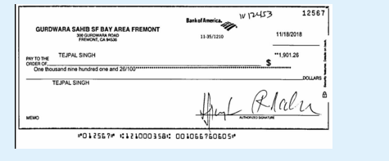
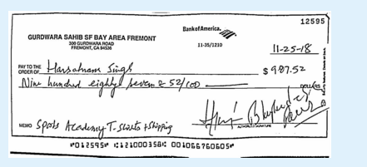
SPORTS ACADEMY CHECKS

Slide 3
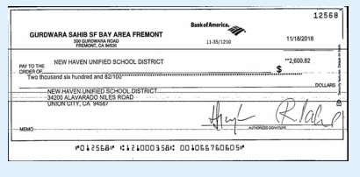
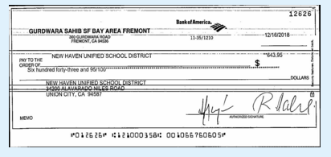
SPORTS ACADEMY CHECKS

Slide 4
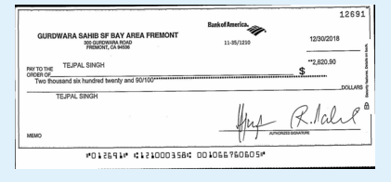
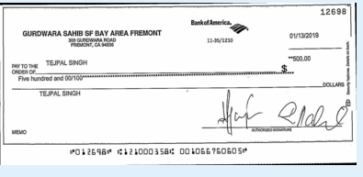
SPORTS ACADEMY CHECKS

Slide 5
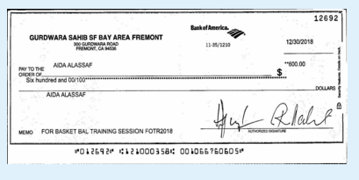
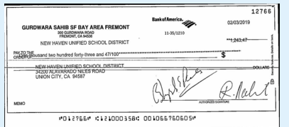
SPORTS ACADEMY CHECKS

Slide 6
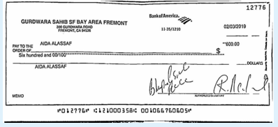
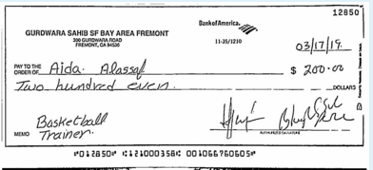
SPORTS ACADEMY CHECKS

Slide 7
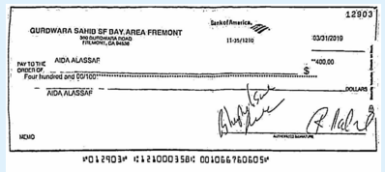
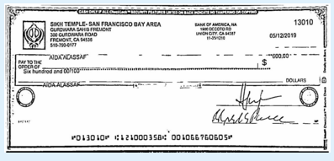
SPORTS ACADEMY CHECKS

Slide 8
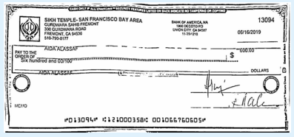
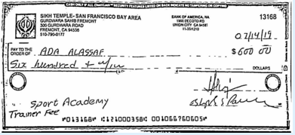
SPORTS ACADEMY CHECKS

Slide 9
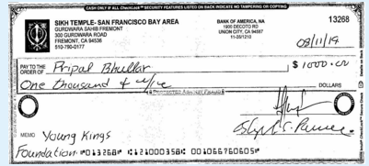
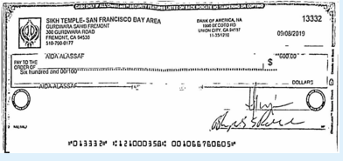
SPORTS ACADEMY CHECKS

Slide 10
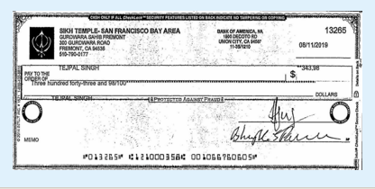
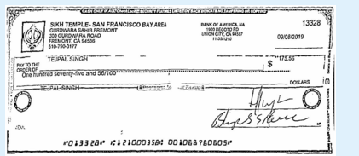
SPORTS ACADEMY CHECKS

Slide 11
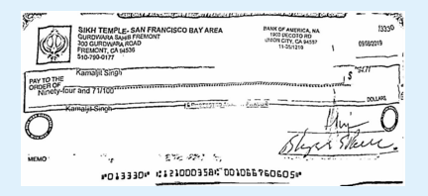
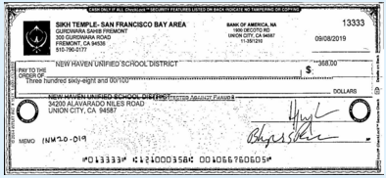
SPORTS ACADEMY CHECKS

